Slide 1
SharePoint Foundation Development
Fundamentals of the SharePoint Development Platform
Notes:
In this module we'll dive into the core development concepts in SharePoint Foundation 2010. Developers will get up to speed on the server-side object model and learn how to debug their solutions using the new Developer Dashboard. In addition students will be introduced to the SharePoint Feature and Solution framework as well as how to leverage the new Feature upgrade improvements added to SharePoint 2010.

Slide 2
Agenda
The Server-side Object Model
The Developer Dashboard
Developing in terms of Features and Solutions
Feature Upgrade Enhancements

Slide 3
SharePoint Terminology Review
- Farm (SPFarm)
- Web Application (SPWebApplication)
- Site Collection (SPSite)
- Site (SPWeb)
- List (SPList)
- Item (SPListItem)
- Document Library (SPDocumentLibrary)
- File (SPFile)
- Folder (SPFolder)
Notes:
Everything you can configure in the user interface, is represented by an object in the SharePoint object model. The farm, web applications and site collections you can configure in the Central Administration, is represented by the SPFarm object, the SPWebApplication objects and the SPSite objects.
The sites are represented by SPWeb objects. Each list in the site is of type SPList and each item in the list is of type SPListItem. Some lists are document libraries and they are of type SPDocumentLibrary, which inherits from SPList. Items in a document library consists of object of type SPFile and SPFolder.

Slide 4
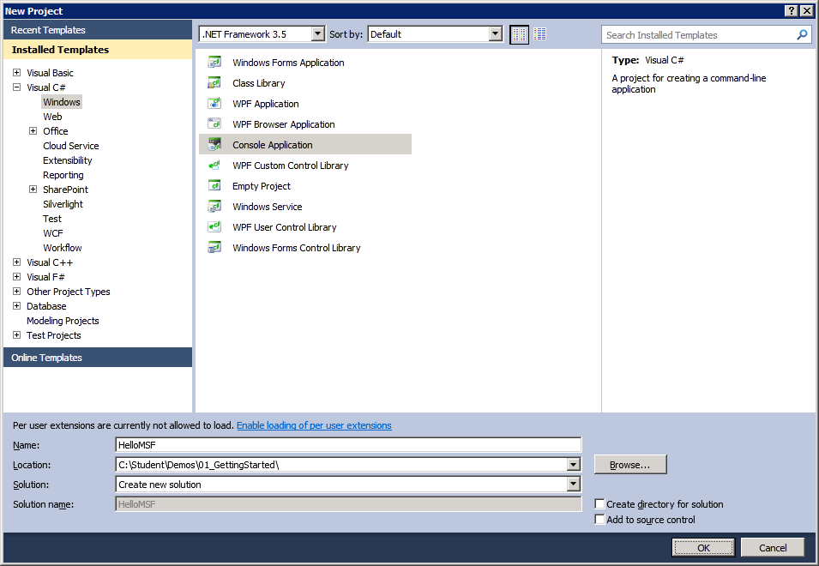
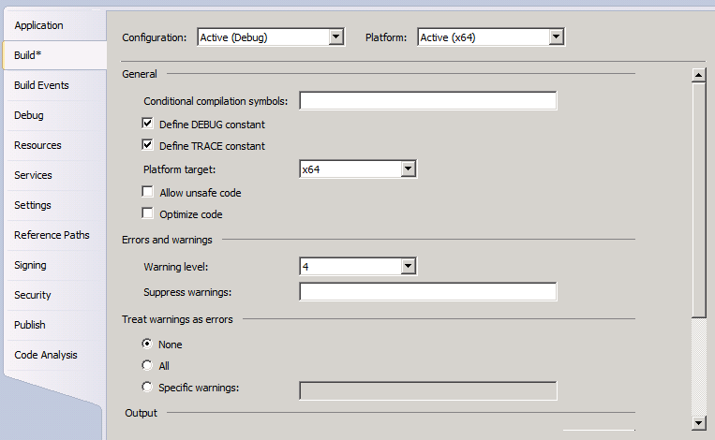
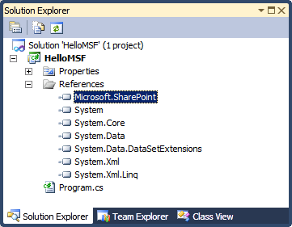
Programming with Microsoft.SharePoint.dll
Creating a Console Application
Create new application based on .NET Framework 3.5
Change project's Platform target to
x64 or AnyCPU.
Default setting of x86 causes errors!
Add reference to Microsoft.SharePoint.dll
Notes:
Using Visual Studio 2010 you can create a console application to work with the SharePoint 2010 object model. When creating the console application, you have to pay attention that the .NET Framework 3.5 is selected and not.NET Framework 4.0.
In the Project Properties you have to change the project Platform target to x64 or Any CPU.
If you want to work with the SharePoint object model, you have to add a reference to the Microsoft.SharePoint.dll which is located in the 14\ISAPI directory.

Slide 5
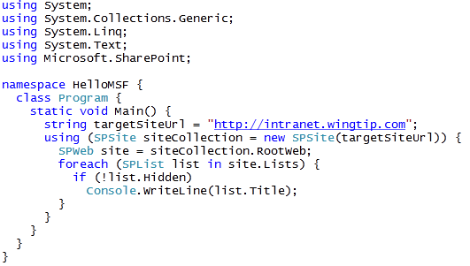
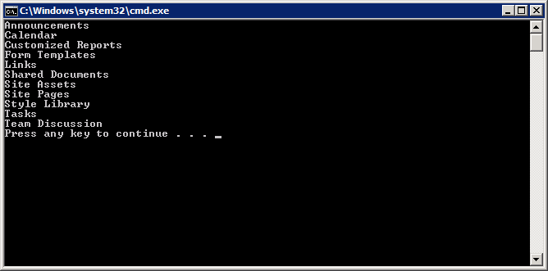
Remember This Code from WSS v3?
Notes:
After having added a reference to the Microsoft.SharePoint.dll you have access to the core part of the SharePoint object model.
You can create an SPSite object based on the URL of your SharePoint site. Use the using construct to make sure the Dispose method is called to avoid memory leaks. If you don’t use the using construct, just make sure you call the Dispose method on the objects of type SPSite and SPWeb when you don’t need them anymore.
Many collections in SharePoint object model support For Each enumeration.

Slide 6
DEMO
Programming against the SharePoint Object Model

Slide 7
Agenda
The Server-side Object Model
The Developer Dashboard
Developing in terms of Features and Solutions
Feature Upgrade Enhancements

Slide 8
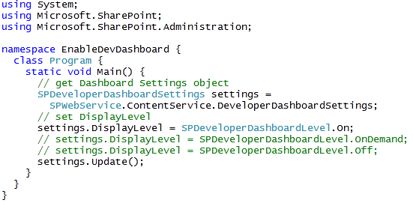
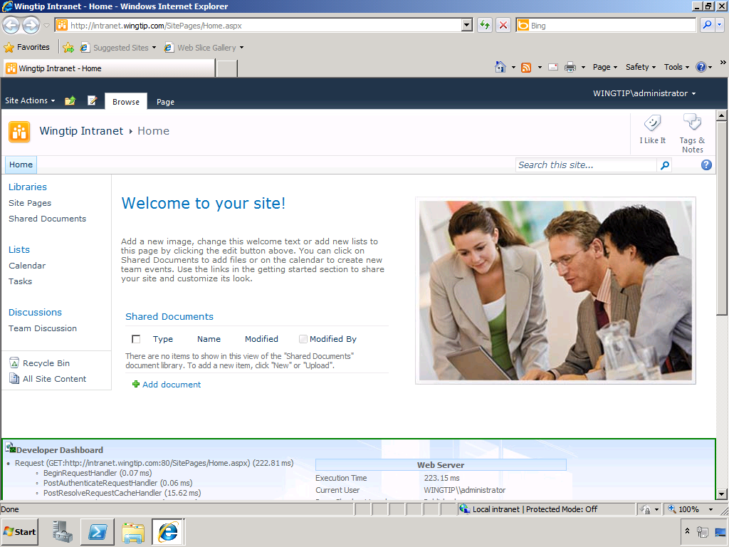
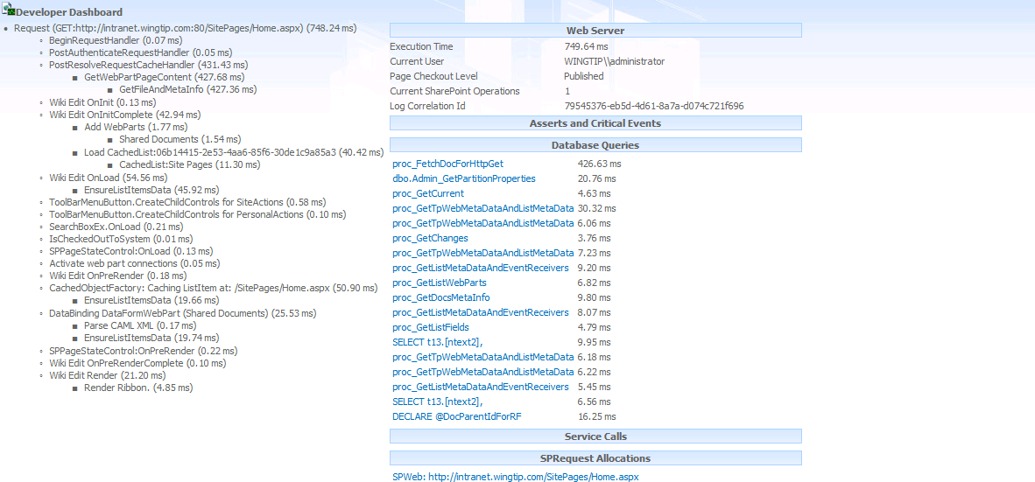
SharePoint 2010 Developer Dashboard
Notes:
The developer dashboard has been introduced with SharePoint Server 2010. It shows diagnostics and performance-related statistics.
How long did the request take to run?
What event handlers were fired?
In what sequence did these event handlers fire?
There is no built-in UI component that allows a user to enable and disable the developer dashboard. However, you can create a simple Console application or Windows PowerShell script that does the trick.

Slide 9
DEMO
Using The Developer Dashboard

Slide 10
Agenda
The Server-side Object Model
The Developer Dashboard
Developing in terms of Features and Solutions
Feature Upgrade Enhancements

Slide 11
SharePoint Solutions
SharePoint development based on solutions
Solution is a CAB file with a *.wsp extension
Solution is a container of files distributed as a unit
Solution contain manifest with instructions for installer
Solutions can be deployed two different ways
As a farm solution
As a sandboxed solution - new in SharePoint 2010
Notes:
A SharePoint solution (*.WSP) is a Microsoft cabinet file (*.CAB) that contains files to deploy to SharePoint servers. Files that can be deployed include anything that would go in the SharePointRoot folder (\[...]\14\) or assemblies that would go in a Web application’s \BIN folder or the server’s global assembly cache.
Solutions deployed to the farm (the only type of solutions deployed in SharePoint 2007) are available across the farm. A new type of solution, the “sandbox solution” allows site collection administrators to deploy custom code solutions to SharePoint.

Slide 12
The SharePointRoot Directory
SharePoint Foundation relies on set of template files
Stored in special directory known as SharePointRoot
SharePointRoot located on file system of each WFE at this path
C:\Program Files\Common Files\Microsoft Shared\Web Server Extensions\14
Farm solutions deploy their files into child directories
Path relative to SharePoint Root | Template file types
/ISAPI | Web Services (*.svc, *.ashx and *.asmx)
/Resources | Resource files (*.resx)
/TEMPLATE/ADMIN | Application pages used exclusively in Central Administration
/TEMPLATE/CONTROLTEMPLATES | ASP.NET User Controls (*.ascx)
/TEMPLATE/FEATURES | Feature definition files (*.xml)
/TEMPLATE/IMAGES | Images (*.gif, *.jpg and *.png)
/TEMPLATE/LAYOUTS | Application pages (*.aspx)
/TEMPLATE/LAYOUTS/1033/STYLES | CSS Files (*.css)
/TEMPLATE/LAYOUTS/ClientBin | Silverlight components (*.xap)
/TEMPLATE/SiteTemplates | Site Definition files (onet.xml)
/TEMPLATE/XML | Custom field type definition files (fdltype*.xml)
Notes:
The SharePoint system directory (/[…]/14/) has been given an official name in SharePoint 2010: the SharePointRoot.

Slide 13
Designing and Implementing Features
What is a SharePoint Feature?
Formally known as a “feature definition”
A unit of design and implementation
A building block for creating SharePoint solutions
Features can contain elements
e.g. menu items, links, list types and list instances
Many other element types possible
Features can contain event handlers
Implemented using a feature receiver class
Event handler code can program using SharePoint OM
Notes:
Features can be used to deploy any type of customization:
Web Parts
Application pages
Event handlers
Custom actions
Site columns
Content types
List definitions and list instances
Master pages

Slide 14
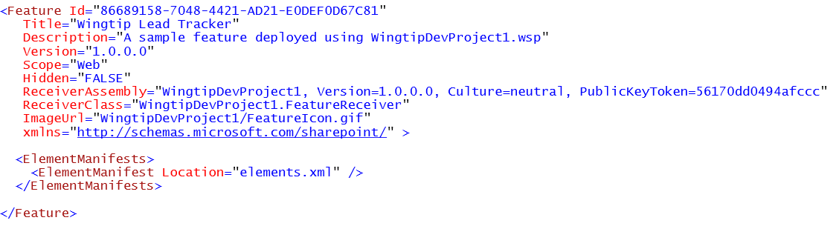
The feature.xml file
feature.xml serves as feature manifest file
Defines attributes for feature definition
Can reference one or more element manifests
Can reference a feature receiver
Notes:
The Feature definition file (feature.xml) provides metadata information to SharePoint as well as register the actions the Feature should perform when activated (element manifests) and files related to the Feature (element files).

Slide 15
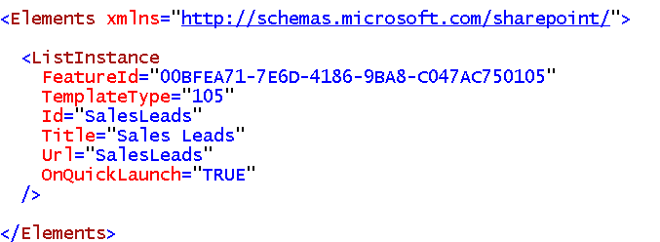
Element Manifest Files
Element manifest contain declarative elements
ListInstance elements creates list during activation
Many other element types available
element manifest can contain many elements
feature.xml file can reference many element manifests
Notes:
The element manifest files in Features is the way you will declaratively do work when a Feature is activated.

Slide 16
Element Types
Many available element types
List of the most common:
Element Type | Description
PropertyBag | Used to add name-value properties to feature
ListInstance | Used to create a list instance
CustomActionGroup | Used to create a new section for links
CustomAction | Used to create a new link or menu command
HideCustomAction | Used to hide a built-in or custom link or menu command
Module | Used to provision a file from a template file
Field | Used to create a site column
ContentType | Used to create a content type
ContentTypeBinding | Used to add a content type to a list
ListTemplate | Used to create a custom list type
Control | Used to create a delegate control
Workflow | Used to create a workflow template
WorkflowActions | Used to create declarative workflows
WorkflowAssociation | Used to associate a workflow template with a list
FeatureSiteTemplateAssociation | Used to staple a feature to a site definition

Slide 17
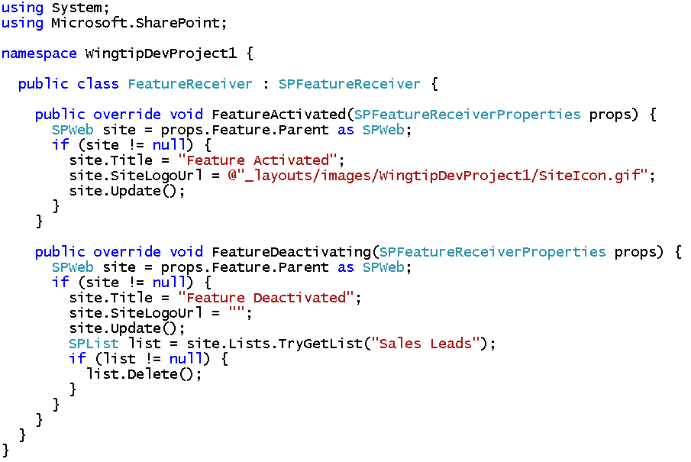
Feature Receivers
Feature receiver used to add event handlers
Must derive from SPFeatureReceiver
Override base class methods to add event handlers
Notes:
When the element manifest files can’t provide the necessary functionality desired when activating a Feature, developers can implement one of the four events exposed in the lifetime of a Feature. SharePoint will execute this code at specific times during the Feature’s life cycle.
The events available include :
FeatureInstalled– runs after the Feature has been installed.
FeatureActivated– runs after the Feature has been activated.
FeatureDeactivating– runs before the Feature is deactivated.
FeatureUninstalling– runs before the Feature is uninstalled.

Slide 18
Deployment using Solution Packages
What is a solution package?
A mechanism for best practice deployment
Atomic unit of reuse, deployment and versioning
A set of files and manifest with installation instructions
A CAB file with *.wsp extension
What can be deployed via a solution package
Feature definitions
Images
Assemblies
And much more…
Notes:
Features can be deployed to SharePoint using solution packages. A solution package is a *.cab file with extension *.wsp and contains the files that make up the different features in the solution package.

Slide 19
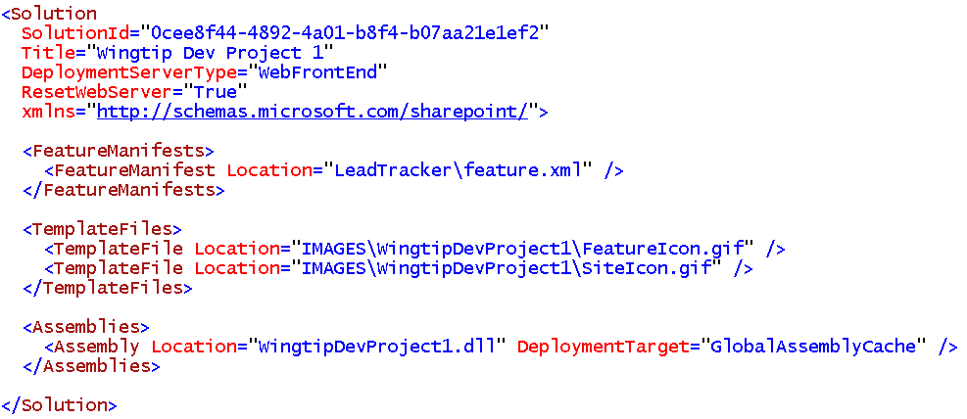
The manifest.xml file
Each Solution Package requires manifest.xml file
Mainly serves as instructions to installer on WFE
Notes:
A solution package also contains a manifest.xml. This file defines the list of features, site definitions, resource files, Web Part files, and assemblies to process.

Slide 20
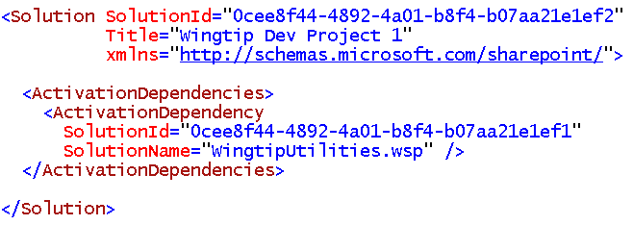
Activation Dependencies
Creates dependency between solution packages
New in SharePoint 2010
ActivationDependency element added to manifest.xml file
Example: SolutionB has dependency on SolutionA
SolutionA must be deployed before SolutionB
Deployment of SolutionB fails if SolutionA is not already deployed
Deployment time error is preferred over run time errors
Notes:
An ActivationDependencyblocks the solution from being deployed if the referenced solution has not already been deployed. This is a useful tool when many solutions are dependent upon another solution that should be deployed to the farm such as a shared library or suite of tools.

Slide 21
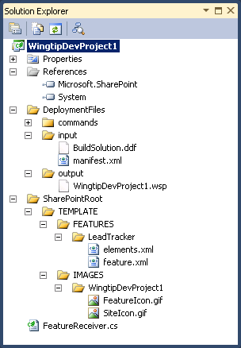
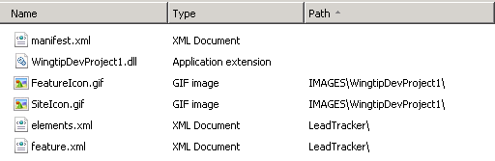
Creating Solutions with Visual Studio 2008
Can be done using Class Library project
Project folder structure mirrors SharePoint Root
Developer maintains solution manifest (manifest.xml)
Developer creates *.ddf file and use MAKECAB.EXE
Manifest.xml
Instructions
for installer
on WFE
WingtipDevProject1.wsp
.DDF
MAKECAB.EXE
NOTE: The Visual Studio 2010 SharePoint Tools will be discussed next lecture and will automate the process of generating the *.wsp file and making it transparent to the developer
Notes:
Solution packages can be created using Visual Studio by creating a simple class library project. The project folder has to reflect the SharePoint root.
The manifest.xml must be created in the root of the project.
Because the solution file is essentially a *.cab file, you can use the makecab.exe tool to create the solution package. The makecab.exe tool takes a pointer to a *.ddf(Diamond Definition File) file, which describes the structure of the *.cab file. In the *.ddffile you declare a standard header and then enumerate, one file per line, the set of files by where they live on disk, separated by where they should live in the *.cab file.

Slide 22
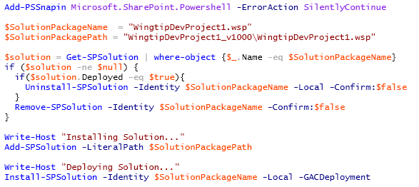
Farm Solution Deployment
Done using Windows PowerShell scripts
Call Add-SPSolution to install solution package Copies *.wsp file to the configuration database
Call Install-SPSolution to deploy solution package Pushes *.wsp file to each WFE and runs installer
Notes:
The script in the screenshot on this slide demonstrates adding & deploying a farm solution to the farm. However before deploying the solution it first checks to see if the solution is already present and/or deployed. If so, it retracts (uninstalls) the solution and then removes it from the solution store.
The process of adding/updating/removing a sandbox solution is very different as it will be uploaded to a special gallery the same way documents are uploaded to document libraries.

Slide 23
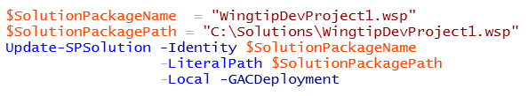
Updating a Farm Solution
Used to push out new files to WFE
Used to replace images or DLLs with new version
Used in feature upgrade
Watch out…
Solution update doesn’t automatically upgrade features
Notes:
The script in the screenshot on this slide demonstrates how to update a farm solution. This is a preferred way to updating previous deployed solutions. When the upgrade/update process runs, it overwrites the existing *.WSP in the farm solution store and then redeploys it to all Web applications it was previously deployed to.

Slide 24
DEMO
Developing and Testing a SharePoint Solution

Slide 25
Agenda
The Server-side Object Model
The Developer Dashboard
Developing in terms of Features and Solutions
Feature Upgrade Enhancements

Slide 26
Feature Upgrade
Used to version feature instances in production
New with SharePoint 2010
How does it work?
Feature definition is modified with Upgrade Actions
New feature definition pushed out using solution update
Feature instances queried and explicitly upgraded
Notes:
Previously SharePoint did not have a way to upgrade deployed Features. Developers were left to write custom code to handle these scenarios on their own.
New to SharePoint 2010 is the ability to write custom upgrade actions. There is a declarative option but when that doesn’t satisfy the requirements, developers are given a way to wire up custom code.

Slide 27
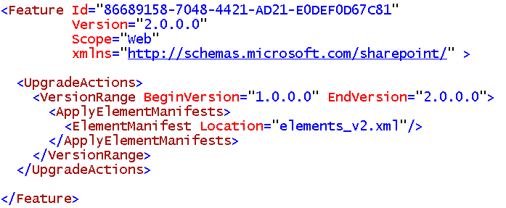
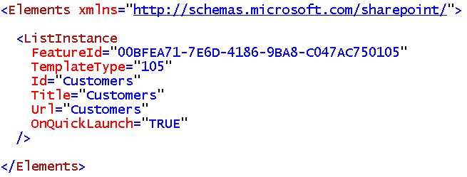
UpgradeActions
Instructions for what to do during feature upgrade
ApplyElementManifest – used to process element manifest
CustomUpgradeAction – used to execute event handler
MapFile – used to remap existing file URL to new physical file
AddContentTypeField – used to add new column to existing content type
Notes:
With SharePoint 2007 you already had some upgrade scenarios but they are far from complete.
SharePoint 2010 addresses this problem by adding upgrade actions to the schema. These actions allow for declarative upgrades and code-based upgrades. Define declarative upgrades using elements like <ApplyElementManifests>, <AddContentTypeField>, <MapFile>, <CustomUpgradeAction>. Code-based upgrades are defined using the <CustomUpgradeAction> element.
There is also a FeatureUpgrading event added to the FeatureReceiver class. This event is triggered when a feature is upgraded.

Slide 28
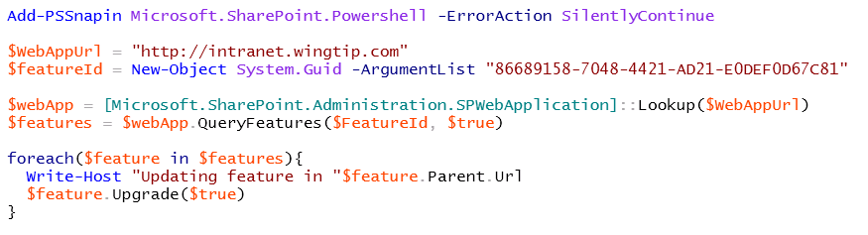
Triggering Feature Upgrade
Updating solution do not trigger feature upgrade
Feature instances must be queried and upgraded
Typically done using a Windows PowerShell script
Notes:
The process of upgrading a Feature is not an automation action. This is something a developer or administrator must perform at the console of the server.
The snippet in the screenshot in this slide demonstrates a process of getting a list where a specific Feature has been activated. It then walks through all these instances it found and upgrades each one.

Slide 29
DEMO
Feature Upgrade

Slide 30
Summary
The Server-side Object Model
The Developer Dashboard
Developing in terms of Features and Solutions
Feature Upgrade Enhancements

